Slide 1
Malachi
The man and the background to the book

Slide 2

The Word of God in action
Ps 33:6,9 By the word of the LORD were the heavens made; and all the host of them by the breath of his mouth… For he spake, and it was done; he commanded, and it stood fast”
Psalm 103:20 His angels, that excel in strength, do his commandments, hearkening unto the voice of his word.

Slide 3


The Word of God in action
Jer 23:28 The prophet that hath a dream, let him tell a dream; and he that hath my word, let him speak my word faithfully.
Prov 13:17 A wicked messenger H4397 falleth into mischief: but a faithful ambassador [envoy] is health.
4397 mal’âk
From an unused root meaning to despatch as a deputy; a messenger; specifically of God, that is, an angel (also a prophet, priest or teacher): - ambassador, angel, king, messenger.
But the angel H4397 of the LORD said to Elijah the Tishbite, Arise, go up to meet the messengers H4397 of the king of Samaria, and say unto them…

Slide 4

Divine messengers
2 Chron 36:15 And the LORD God of their fathers sent to them by his messengers, rising up betimes, and sending…
16 But they mocked the messengers of God, and despised his words, and misused his prophets…
Isa 44:24 Thus saith the LORD, thy redeemer…
26 That confirmeth the word of his servant, and performeth the counsel [advice, purpose] of his messengers; that saith to Jerusalem, Thou shalt be inhabited…
28 That saith of Cyrus, He is my shepherd…

Slide 5
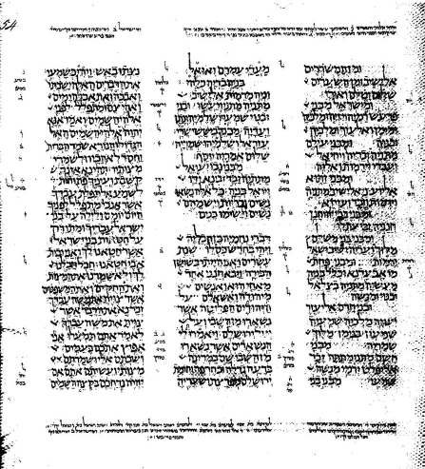
Esther
Ezra
Nehemiah
Haggai
Zechariah
Malachi
A page from the Leningrad Codex with the text of Ezra 10:24–Nehemiah 1:9a
Notes:
Outpouring of revelation - all within 100-120 yrs
Esther: Jews preserved
Ezra: restoration of Jerusalem, Temple
Nehemiah: reconstruction of Jerusalem

Slide 6
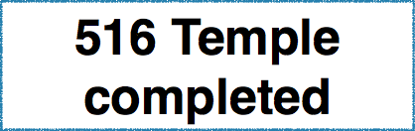

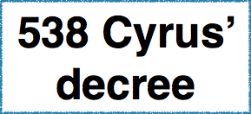

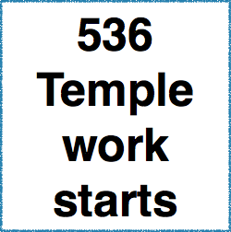
Z
BC
540
H
Z

Slide 7
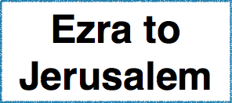
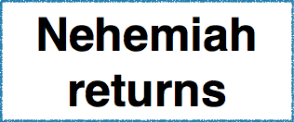
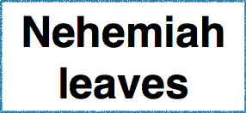

Z
E
BC
540
N
Neh 5:14 12 yrs
H
Z

Slide 8
Nehemiah’s Jerusalem
Temple foundations completed
  Survivors suffering ‘great affliction and reproach’
  Walls of Jerusalem broken down and gates destroyed
South: Edomites
West: Philistines
North: Samaritans
East: Moabites
Almost no houses or inhabitants; rubble and stones
Other towns: hostile, other languages and idolatry
Notes:
Temple foundations completed through Joshua and Zerubbabel
Survivors who escaped Neb’s exile suffering ‘great affliction and reproach’ (Neh 1:3)
Walls of Jerusalem broken down and gates destroyed by fire - Neb or Haman
Almost no houses or inhabitants, strewn with rubble and stones
Towns and villages around jerusalem occupied by aliens who spoke other languages and idolatrous worship - Edomites to the south, Philistines to the west, Smaritain apostates north, Moabites east

Slide 9
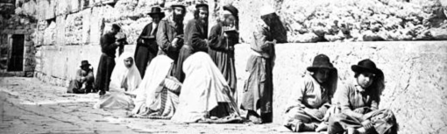
1870s
1880s
1891
Notes:
Temple foundations completed through Joshua and Zerubbabel
Survivors who escaped Neb’s exile suffering ‘great affliction and reproach’ (Neh 1:3)
Walls of Jerusalem broken down and gates destroyed by fire - Neb or Haman
Almost no houses or inhabitants, strewn with rubble and stones
Towns and villages around jerusalem occupied by aliens who spoke other languages and idolatrous worship - Edomites to the south, Philistines to the west, Smaritain apostates north, Moabites east
https://commons.wikimedia.org/wiki/File:Jew%27s_Wailing_Place,_Jerusalem.jpg
Jews at the Western Wall, Félix Bonfils, Albumen silver print.1870s
https://commons.wikimedia.org/wiki/File:Jews_at_Western_Wall_by_Felix_Bonfils,_1870s.jpg
https://commons.wikimedia.org/wiki/File:British_police_wailing_wall1.jpg
British police 1934
https://en.wikipedia.org/wiki/File:Jewish_legion_hakotel_1917.jpg

Slide 10

A portion of Nehemiah’s wall
Notes:
A portion of the wall Nehemiah built in 445 BC. The upper portions of this wall was rebuilt by the Hasmoneans. This is located on the east side of the City of David below the palace and next to the Jebusite’s Stepped Stone Structure.
http://www.generationword.com/jerusalem101/27-nehemiah-wall.html

Slide 11
Nehemiah’s ‘broad wall’ (12:38)
Notes:
http://www.generationword.com/images/Labeled_Photos_of_Israel/Israel-labeled-pics/hezekiah-wall.jpg

Slide 12
Nehemiah’s covenant
Behaviour | The "covenant"
1. Worship and law | Neh 10:28,29, etc
2. Marriage out of the faith | Neh 10:30
3. Violation of sabbath | Neh 10:31
4. Tithes | Neh 10:32,38
5. Wood offering | Neh 10:34
6. Observance of firstfruits and firstborns | Neh 10:35,36

Slide 13
Timing the prophecy
1:8 “offer it now unto thy governor"
  Ezra
  Nehemiah
  Esther
  Haggai

Slide 14

Timing the prophecy
1:8 “offer it now unto thy governor"
1:7-10 Temple completed and in use

Slide 15

Timing the prophecy
1:8 “offer it now unto thy governor"
1:7-10 Temple completed and in use
3:16 Fearing the Name
Neh 1:11 O Lord, I beseech thee, let now thine ear be attentive to the prayer of thy servant, and to the prayer of thy servants, who desire to fear thy name…

Slide 16
Z
E
BC
540
M
N
H
Z

Slide 17
Behaviour | Nehemiah | Malachi
1. Non-payment of tithes | Neh 13:9,10 | Mal 3:8
2. Temple services not respected/ceased | Neh 13:10 | Mal 1:7,12,13
3. Violation of sabbath | Neh 13:15 | Mal 3:14; 4:4
4. Marriage out of the faith | Neh 13:23,24 | Mal 2:11-16
5. Wood offering | (Neh 13:31) | --
6. Observance of firstfruits and firstborns | (Neh 13:11,12) | --
7. Jewish men repudiating their wives | Neh 13:23,27 | Mal 2:15-16
Why did Nehemiah come back? Who told Nehemiah what was going on?

Slide 18
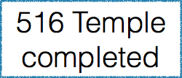

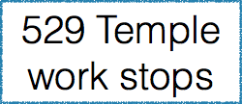
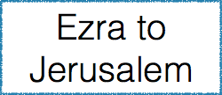
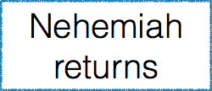







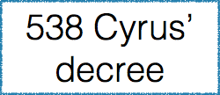

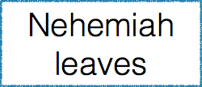
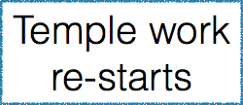
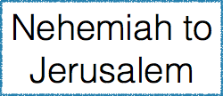
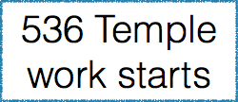
Z
E
BC
540
M
N
H
Z
Notes:
538 Cyrus’ decree; Jews return under Zerubbabel; temple work starts (Ezra 1-6)
529 Letter of opposition from the Samaritans; temple work stops
520 Cyrus’ decree re-discovered; temple work re-starts
515 2 Chr 36:21 Dedication of Temple
458 Ezra to Jerusalem: Restore Mosaic Law (Ezra 7-10), reform of priesthood
444 Nehemiah’s interview; perhaps Queen Esther sitting by; to Jerusalem for 12 years
432 Nehemiah leaves Jerusalem (Neh 5:14, 13:6)
Malachi’s prophecy fits here between Neh 12 and 13
?Word reaches Nehemiah and he returns (chapter 13)

Slide 19
Malachi’s messengers
1:1
Malachi
Mal`akiy
  2:7
  The priests
  3:1 John the Baptist
3:1 Jesus
4:5 Elijah the prophet

Slide 20
Ten Questions from the people
1:2 Yet ye say, Wherein hast thou loved us?
1:6 And ye say, Wherein have we despised thy name?
1:7 and ye say, Wherein have we polluted thee?
(2:11 Judah hath dealt treacherously,) 2:14 Yet ye say, Wherefore?
2:17 Yet ye say, Wherein have we wearied him?
2:17 Where is the God of judgment?
3:7 But ye said, Wherein shall we return?
3:8 But ye say, Wherein have we robbed thee?
3:13 Yet ye say, What have we spoken so much against thee?
3:14 Ye have said,It is vain to serve God: and what profit is it that we have kept his ordinance, and that we have walked mournfully before the LORD of hosts?

Slide 21
Ten Questions from God
1:6 where is mine honour? where is my fear?
1:8 If ye offer the lame and sick, is it not evil?
1:8 Offer it now unto thy governor; will he be pleased with thee…?
1:9 beseech God that he will be gracious unto us: will he regard your persons?
1:10 Who is there even among you that would shut the doors for nought?
(Malachi - 2:10 why do we deal treacherously every man against his brother, by profaning the covenant of our fathers?)
(Malachi - 2:15 And did not he make one?)
(Malachi - 2:15 And wherefore one?)
3:2 But who may abide the day of his coming? who shall stand when he appeareth?
3:8 Will a man rob God?

Slide 22
Yahweh’s challenge |  | Faithless response
1:2 | I have loved you, saith the LORD | 1:2 | Wherein hast thou loved us?
1:6 | Where is mine honour? O priests that despise my name | 1:6 | Wherein have we despised thy name?
1:7 | Ye offer polluted bread upon mine altar… Yahweh’s table is contemptible | 1:7 | Wherein have we polluted thee?
2:11,14 | Judah hath dealt treacherously… the wife of thy youth | 2:14 | Wherefore?
2:17 | Ye have wearied the LORD with your words. | 2:17 | Wherein have we wearied him?
3:7 | Return unto me, and I will return to you | 3:7 | Wherein shall we return?
3:8 | Will a man rob God? Yet ye have robbed me | 3:8 | Wherein have we robbed thee?
3:13 | Your words have been stout against me, saith the LORD | 3:13 | What have we spoken so much against thee?

Slide 23
What they said |  | The effect of their thinking
1:2 God’s love? nothing to show for it | 1:6 We are showing quite enough respect already | Nothing special about Yahweh or his name
1:7 We can offer polluted bread upon the altar: | 1:7 The table of the LORD is contemptible | There is nothing special about Yahweh’s worship
1:8 We can offer a sub-standard sacrifice | 1:9 Then we can ask God to be gracious to us | God should accept whatever we offer him
2:17 Doing evil is good in the sight of the Yahweh | He delights in evil; where is the God of judgment? | God doesn’t do anything to punish evildoers
1:10 Why serve the temple unless I benefit? | 3:14 Vain to serve God: what benefit is it that we have kept his ordinance? | There is no point in serving God
3:7 Why does God say we have departed from him? | 3:8 Why does God say we have robbed him? | There is nothing wrong with our worship

