Slide 1
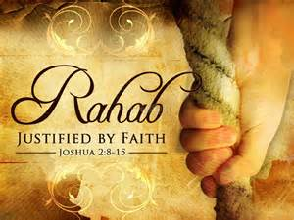
Rahab
By faith... The harlot Rahab "she had received the spies with peace"

Slide 2
Rahab’s name
Word is used 11 times in scripture 11 = Disorder
3 times they are not talking about Rahab
Slightly different word = Loud, Stubborn or Proud
Ps 87:4 Ps 89:10 & Is 51:9 all speaking of Egypt
Her Name Rahab = Broad or Wide
Words of Christ
“Enter ye in at the strait gate: for wide is the gate, and broad is the way, that leadeth to destruction, and many there be which go in thereat” Matt 7:13

Slide 3
Rahab’s name
Rahab – Used 8 times in scripture
Verse | Described as a Harlot | Verse | Not as a Harlot
Josh 2:1 | Harlot’s house Rahab | Josh 2:3 | Rahab
Josh 6:17 | Rahab the harlot | Matt 1:5 | Rachab
Josh 6:23 | Rahab the harlot
Josh 6:25 | Rahab the harlot
Heb 11:31 | The harlot Rahab
Jam 2:25 | Rahab the harlot
Used 5 times in OT = Grace
Used 3 times in NT = Seed that brings forth fruit

Slide 4
Rahab’s Occupation
Harlot - zanah OT:2181
[Gesenius] To commit Fornication or Adultery to go a whoring after
A harlot, a whore or a prostitute
He goes to great lengths to state that those who try to say the word reflects a Inn Keeper should not be listened too.

Slide 5
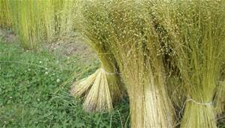
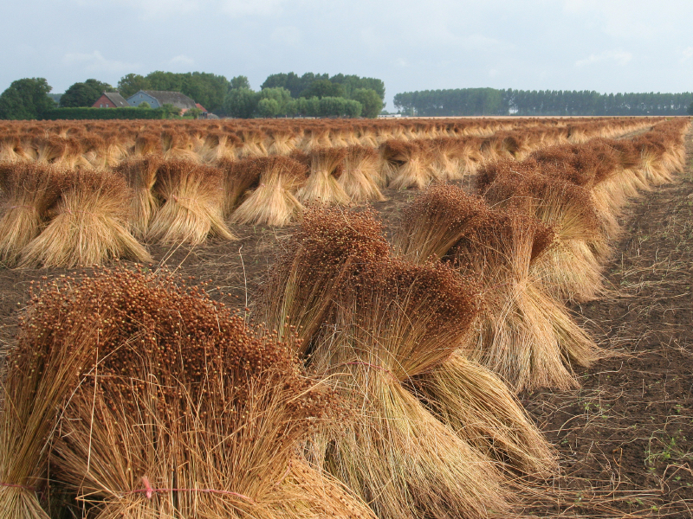
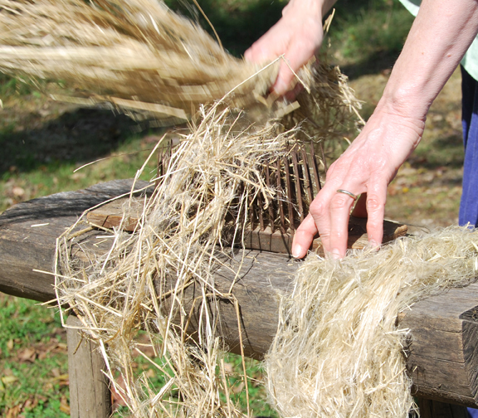
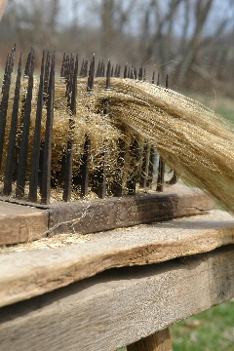
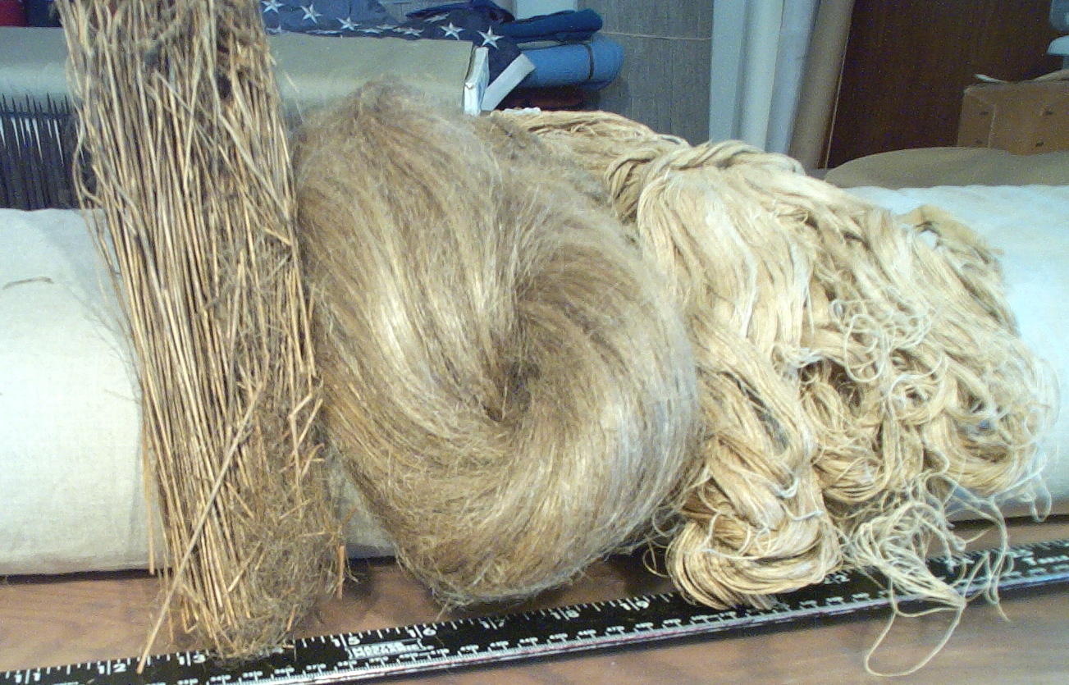
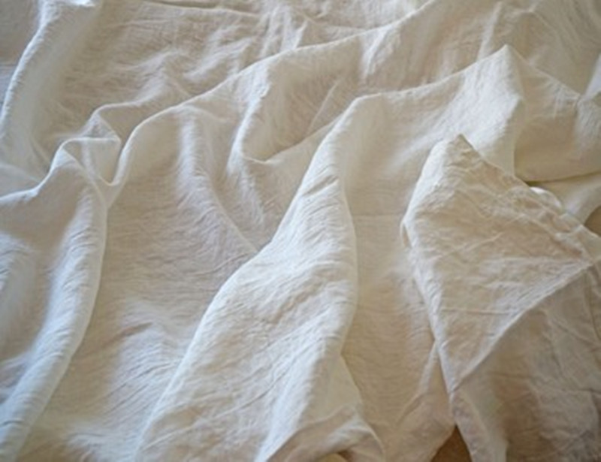
Stages of Flax to Linen
Live plant
Harvest
Drying
Combing
Weaving
Fine Linen
Rev 19:8
“And to her was granted that she should be arrayed in fine linen, clean and white: for the fine linen is the righteousness of saints”.

Slide 6
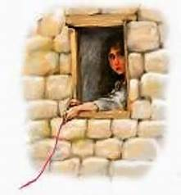
Scarlet thread
GEN 38:28-30 – placed on wrist of one of the sons of Tamar (when she gave birth to twins, after playing the harlot)
Pharez – was the first borne
Zarah - his hand came out first & had the scarlet thread bound to it.
Both are mentioned in Matt 1:5 - line of Christ
Lev 14:4-7
Priestly functions for a Leper

Slide 7
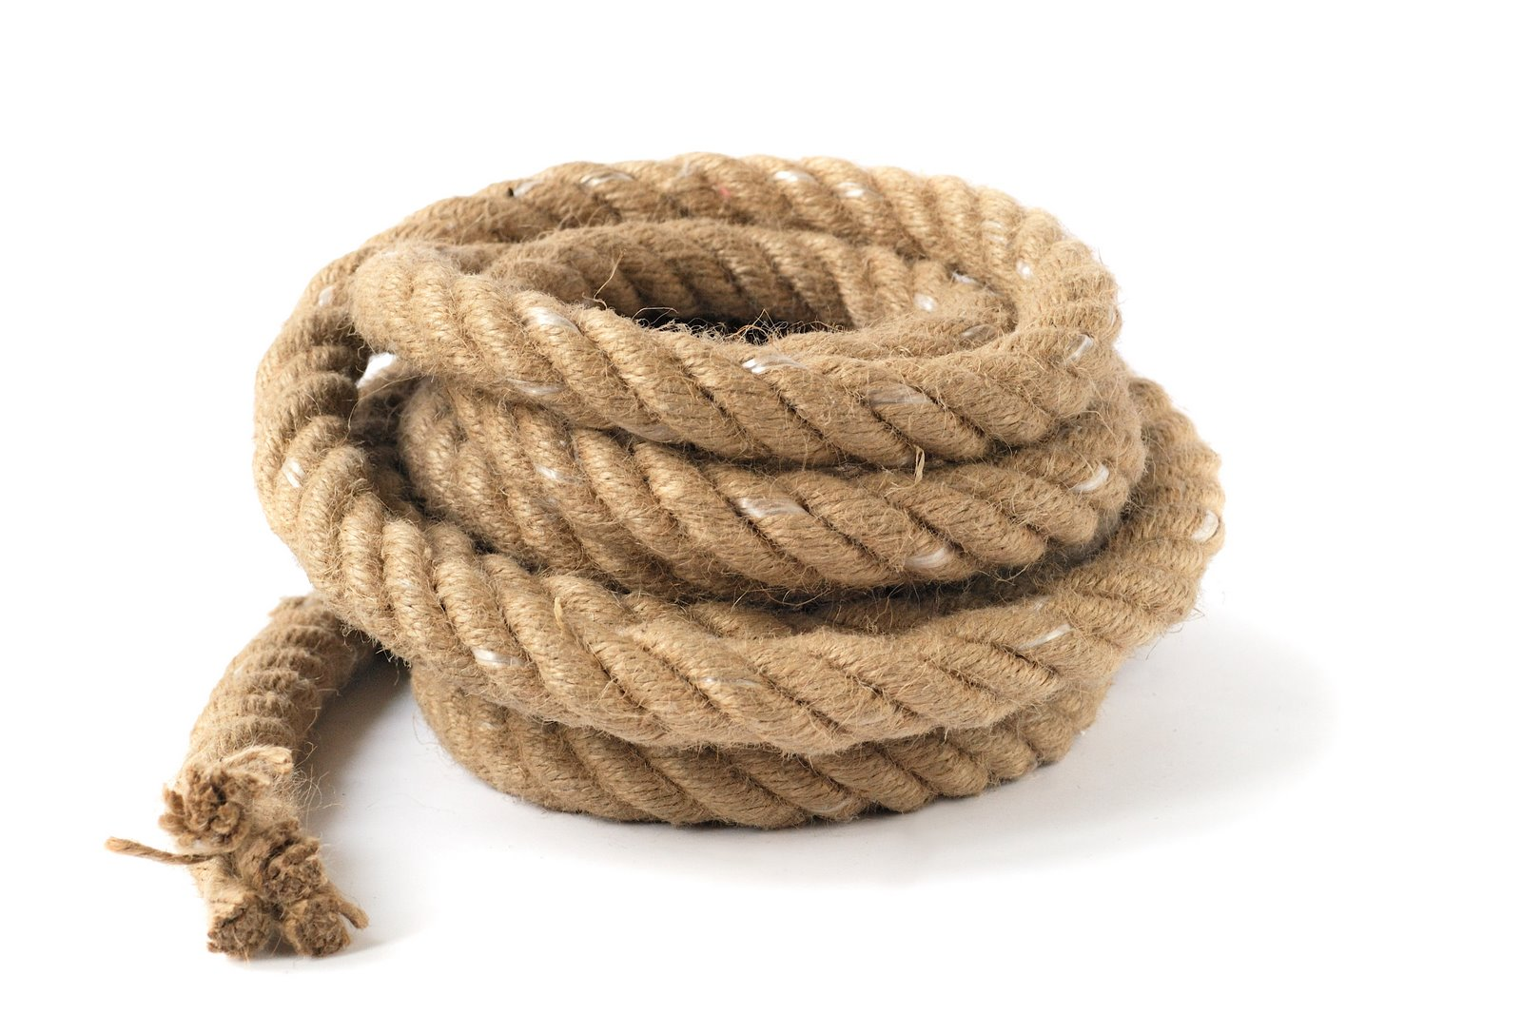
Cord & Scarlet thread
Verse 15 CORD OT:2256
Chebel (kheh'-bel); or chebel (khay'-bel); from OT:2254; a rope (as twisted)

Slide 8
Cord & Scarlet thread
Hosea 11:1-4
A picture of how Yahweh tried to save ISRAEL with rope and thread.
Sadly the nation would not head the warning.
What of us?

Slide 9
Rahab sent them out another way
Joshua 2:16 - Read
James 2:25
Likewise also was not Rahab the harlot justified by works, when she had received the messengers, and had sent them out another way?
Rahab saves the spies by her faith and understanding of spiritual ways – she had changed to think with the mind of the spirit, she knew the way the soldiers of the Jericho would go, so she gives them practical advice
Notes:
Rahab save the spies

Slide 10
Joshua saves Rahab
Joshua 6:25
And Joshua saved Rahab the harlot alive, and her father's household, and all that she had; and she dwelleth in Israel even unto this day; because she hid the messengers, which Joshua sent to spy out Jericho.
Josh 6:27
So Yahweh was with Joshua; and his fame was noised throughout all the country.
Josh 6:23 – Rahab without the camp she still needed to be prepared and cleansed (baptised) like Miriam

Slide 11
Conclusion
Josh 2:21
And she said, According unto your words, so be it. And she sent them away, and they departed: and she bound the scarlet line in the window.

Slide 12
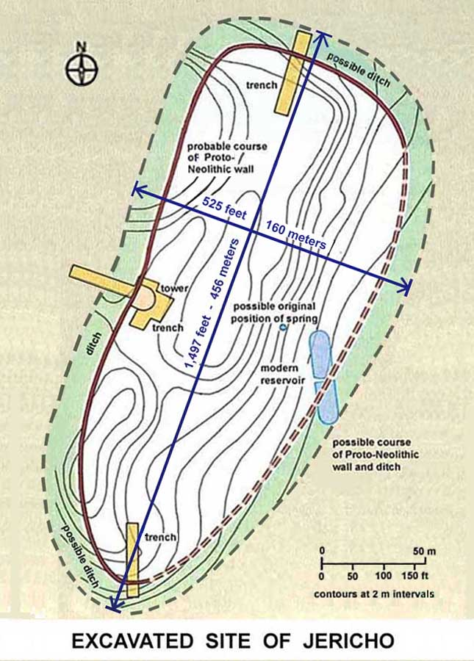
Jericho just 10 acers in size
Notes:
The first archaeological excavations of Tell-es-Sultan (ancient fortified city of Jericho) were made by Charles Warren in 1868. Ernst Sellin and Carl Watzinger excavated between 1907-1909 and in 1911. John Garstang excavated between 1930 and 1936. Extensive investigations using more modern techniques were made by Kathleen Kenyon between 1952 and 1958. Lorenzo Nigro and Nicolo Marchetti conducted a limited excavation in 1997. Later that same year, Dr. Bryant Wood also made a visit to the site to verify the findings of the earlier 1997 team.
One of the most significant discoveries of the archaeological excavations is the Neolithic tower on the western perimeter of the site. The word “Neolithic” refers to the Stone Age that is characterized by the development of settled agriculture and the use of polished stone tools and weapons.
The Holy Bible informs us that “Abel was a keeper of sheep, but Cain was a tiller of the ground.” (Gen. 4:2) Cain’s son Enoch had built a city (Gen. 4;17). Tubal Cain, the eighth generation from Cain was “an instructor of every craftsman in bronze and iron.” (Gen. 5:22) Canaan is the grandson of Noah (Gen. 10:6). He and his descendants settled down in the land of Canaan and built the ancient city of Jericho (Gen. 10:19).
The size of the excavated site is about 10 acres = 4 hectares, which is close to 7 city blocks in Houston, Texas. The length is 1,497 feet = 456 meters. The width is 525 feet = 160 meters. The height is 65 feet = 19.8 meters.

Slide 13
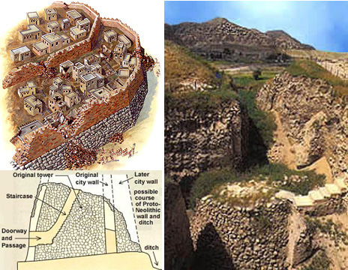
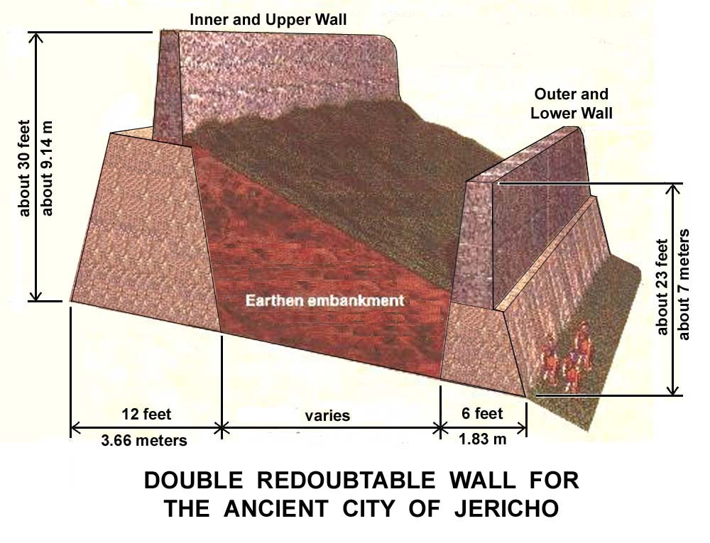
Jericho walls

